Slide 1

Introduction to SQL

Slide 2
Topics to be Covered
Introduction to SQL
SQL Building Blocks
SQL Data Types
Introduction to MySQL
Selecting a Database in MySQL
Creating a Database in MySQL
Deleting/Dropping a Database in MySQL

Slide 3
Introduction to SQL
SQL (Structured Query Language) is a standard language used to store, manage, and manipulate data in a relational database.
It allows users to create databases, insert data, update records, delete records, and retrieve data using queries.
SQL is composed of four parts:
  Data definition language (DDL) includes statements for defining the database and its objects such as tables, views, triggers, stored procedures, etc.
  Data manipulation language (DML) contains statements for updating and querying data.
  Data control language (DCL) allows you to grant permissions to users to access specific data in the database.
  Transaction Control Language (TCL) is a part of SQL that deals with transactions in a database.

Slide 4
SQL Building Blocks
Data Definition Language (DDL):
Used to define the structure of the database.
CREATE → create tables/databases
ALTER → modify tables
DROP → delete tables/databases
Data Manipulation Language (DML): Used to manipulate data.
INSERT → add new records
UPDATE → modify existing records
DELETE → remove records
Data Query Language (DQL):
SELECT → retrieve data from tables
Data Control Language (DCL):
GRANT → give access permissions
REVOKE → remove permissions
Transaction Control Language (TCL):
COMMIT → save changes permanently
ROLLBACK → undo changes
SAVEPOINT → mark a point in a transaction

Slide 5
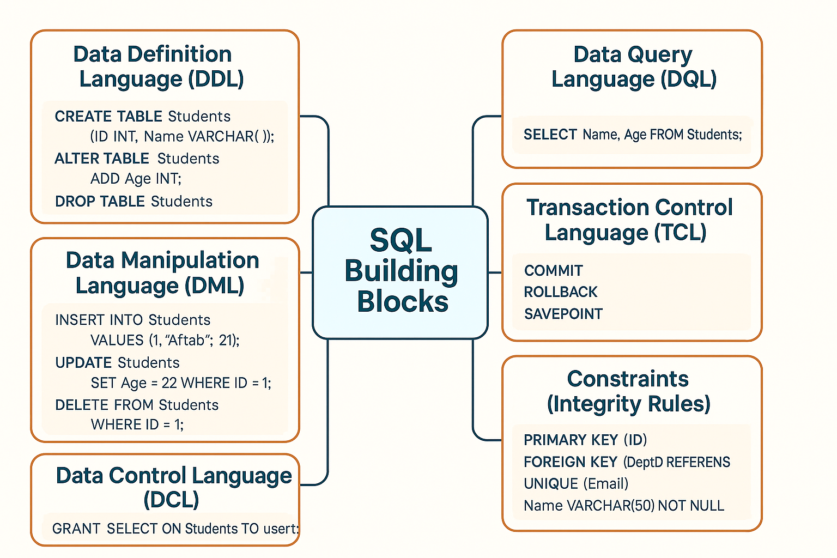
SQL Building Blocks

Slide 6
Data Definition Language (DDL)
Defines the structure of the database (tables, schemas, constraints).
Command | Purpose | Example
CREATE | Create database objects (tables, views, indexes) | CREATE TABLE Students (ID INT, Name VARCHAR(50));
ALTER | Modify database structure | ALTER TABLE Students ADD Age INT;
DROP | Delete database objects | DROP TABLE Students;
TRUNCATE | Remove all records but keep structure | TRUNCATE TABLE Students;

Slide 7
Data Manipulation Language (DML)
Used to manipulate data (insert, update, delete).
Command | Purpose | Example
INSERT | Add new records | INSERT INTO Students VALUES (1, 'Aftab', 21);
UPDATE | Modify existing records | UPDATE Students SET Age = 22 WHERE ID = 1;
DELETE | Remove records | DELETE FROM Students WHERE ID = 1;

Slide 8
Data Query Language (DQL)
Used to query/retrieve data.
Command | Purpose | Example
SELECT | Retrieve data from tables | SELECT Name, Age FROM Students;

Slide 9
Data Control Language (DCL)
Controls access rights & permissions.
Command | Purpose | Example
GRANT | Give user access | GRANT SELECT ON Students TO user1;
REVOKE | Remove user access | REVOKE SELECT ON Students FROM user1;

Slide 10
Transaction Control Language (TCL)
Ensures safe and consistent transactions.
Command | Purpose | Example
COMMIT | Save changes permanently | COMMIT;
ROLLBACK | Undo uncommitted changes | ROLLBACK;
SAVEPOINT | Mark a point in a transaction | SAVEPOINT sp1;

Slide 11
Constraints (Integrity Rules)
Ensure data validity & integrity inside a table.
Constraint | Purpose | Example
PRIMARY KEY | Unique identifier for each record | PRIMARY KEY (ID)
FOREIGN KEY | Links tables together | FOREIGN KEY (DeptID) REFERENCES Department(ID)
UNIQUE | Ensures unique values | UNIQUE (Email)
NOT NULL | Column cannot have NULL value | Name VARCHAR(50) NOT NULL
CHECK | Enforce condition | CHECK (Age >= 18)

Slide 12
SQL Data Types
SQL provides different data types to define the kind of values that can be stored in a table column.
They are mainly grouped into:
  Numeric Data Types
  Character/String Data Types
  Date and Time Data Types
  Binary Data Types
  Other Special Data Types (depending on the RDBMS: MySQL, Oracle, SQL Server, PostgreSQL, etc.)

Slide 13
Numeric Data Types
Data Type | Description | Example Value
INT / INTEGER | Whole numbers | 101, -25
SMALLINT | Small integers | 30000
BIGINT | Large integers | 9876543210
DECIMAL(p,s) / NUMERIC(p,s) | Fixed precision (p = total digits, s = digits after decimal) | DECIMAL(8,2) → 12345.67
FLOAT | Approximate floating number | 3.14
REAL | Single precision floating number | 1.234
DOUBLE PRECISION | High precision floating number | 1234567.123456

Slide 14
Character/String Data Types
Data Type | Description | Example Value
CHAR(n) | Fixed-length string (padded with spaces) | CHAR(10) → "SQL "
VARCHAR(n) | Variable-length string | "Database"
TEXT | Large text data | "This is a long paragraph..."

Slide 15
Date & Time Data Types
Data Type | Description | Example Value
DATE | Stores date (YYYY-MM-DD) | 2025-08-18
TIME | Stores time (HH:MM:SS) | 14:45:20
DATETIME | Stores date + time | 2025-08-18 14:45:20
TIMESTAMP | Auto-updated date & time | 2025-08-18 14:45:20
YEAR (MySQL) | Year values | 2025

Slide 16
Binary Data Types
Data Type | Description | Example Value
BINARY(n) | Fixed-length binary data | 101010
VARBINARY(n) | Variable-length binary data | 11010101
BLOB | Large binary data (images, files, videos) | Image file

Slide 17
Other Special Data Types
Data Type | Description | Example Value
BOOLEAN | Logical values (TRUE / FALSE) | TRUE
ENUM (MySQL) | Predefined set of values | 'Small', 'Medium', 'Large'
JSON | Stores JSON (JavaScript Object Notation) data | {"id":101,"name":"ABC"}
XML | Stores XML (Extensible Markup Language) data | <student><id>101</id></student>

Slide 18
RDBMS using SQL
SQL is used with popular RDBMS (Relational Database Management Systems) such as:
  MySQL
  Oracle
  Microsoft SQL Server
  PostgreSQL
  SQLite

Slide 19
Introduction to MySQL
MySQL is an open-source Relational Database Management System (RDBMS).
It uses SQL (Structured Query Language) to manage and manipulate data.
Developed by MySQL AB (now owned by Oracle Corporation).
MySQL is named after the founder’s daughter "My" + SQL (Structured Query Language).
MySQL’s dolphin logo is called “Sakila”, named after a town in Africa.
One of the most popular databases used for web applications, often with PHP (in the LAMP stack: Linux, Apache, MySQL, PHP/Python/Perl).
When compared to other database software like Oracle Database or Microsoft SQL Server, MySQL is relatively easy to master.
MySQL is versatile and can run on various platforms, including UNIX, Linux, and Windows.

Slide 20
History of MySQL
Year | Event / Milestone
1994 | MySQL AB founded in Sweden by Michael Widenius, David Axmark, Allan Larsson
1995 | First version of MySQL released
2000 | Released under GNU General Public License (GPL) → became open source
2001–2005 | Gained popularity with LAMP stack, adopted by major websites (Yahoo, Facebook, Wikipedia, YouTube)
2008 | Acquired by Sun Microsystems for ~$1 billion
2010 | Oracle Corporation acquired Sun → MySQL becomes part of Oracle
2010s–Present | Still one of the most popular RDBMS; MariaDB fork created by Monty Widenius

Slide 21
Selecting a Database in MySQL
When you log in to a MySQL database server using the mysql client tool without specifying a database name, MySQL server will set the current database to NULL.
First, log in to MySQL using the root user account:
  mysql -u root –p
MySQL will prompt you for a password:
  Enter password:
To log in, you need to provide the correct password of the root user account and press Enter.
To display the current database ; you use the following statement:
  SELECT database();
It’ll return the following:
    +------------+
    | database() |
    +------------+
    | NULL |
    +------------+
    1 row in set (0.00 sec)

Slide 22
Selecting a Database in MySQL Cont..
It means the current database is not set. If you issue a statement, MySQL will issue an error. For example:
  SELECT * FROM table;
Error:
  ERROR 1046 (3D000): No database selected
To select a database to work with, you use the USE statement:
  USE database_name;
For example, the following statement uses the USE statement to set the current database to classicmodels:
  USE classicmodels;
If you see the following message, it means that you have changed the database to classicmodels successfully:
  Database changed
To verify it, you can use the select database() statement:
  SELECT database();

Slide 23
Selecting a Database in MySQL Cont..
It’ll return something like:
  +---------------+
  | database() |
  +---------------+
  | classicmodels |
  +---------------+
  1 row in set (0.00 sec)
If the classicmodels database doesn’t exist, you’ll get the following error after executing the USE statement:
  ERROR 1049 (42000): Unknown database 'classicmodels'

Slide 24
Selecting a Database in MySQL Cont..
In this case, you need to find which databases are available on your server by using the show databases statement:
  SHOW DATABASES;
The output may look like the following:
  +--------------------+
  | Database |
  +--------------------+
  | information_schema |
  | mysql |
  | performance_schema |
  | sys |
  +--------------------+
  4 rows in set (0.02 sec)

Slide 25
Selecting a Database in MySQL Cont..
Selecting a database when you login
If you know which database you want to work with before you log in, you can use the -D flag.
For example, the following command connects to the classicmodels database with the user account root:
  mysql -u root -D classicmodels –p
In this command, we specify the database classicmodels after the -D flag.
After entering the password and logging in successfully, you can check the current database:
  SELECT database();
  Output:
  +---------------+
  | database() |
  +---------------+
  | classicmodels |
  +---------------+
  1 row in set (0.00 sec)

Slide 26
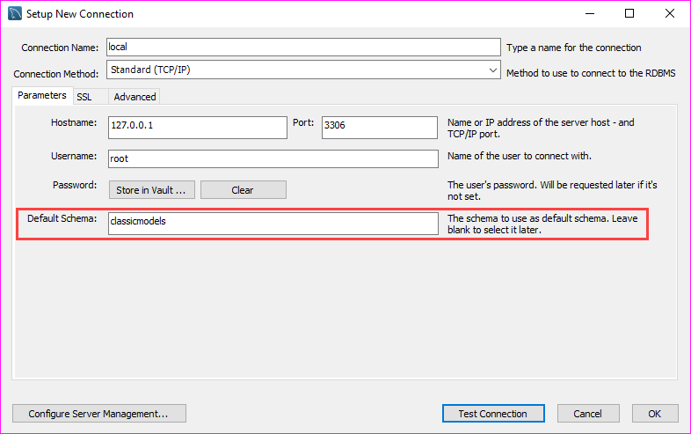
Selecting a Database in MySQL Workbench
If you connect to a MySQL Server via the MySQL Workbench application, you can select a database when you create the database connection as shown in the following screenshot:

Slide 27
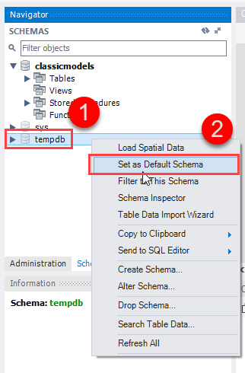
Selecting a Database in MySQL Workbench Cont..
Once logged in, you can select another database by issuing the USE statement or use the Set as Default Schema feature provided by MySQL Workbench:

Slide 28
Creating a Database in MySQL
To create a new database in MySQL, you use the CREATE DATABASE statement.
The following illustrates the basic syntax of the CREATE DATABASE statement:
  CREATE DATABASE [IF NOT EXISTS] database_name
  [CHARACTER SET charset_name]
  [COLLATE collation_name];
In this syntax:
First, specify the name of the database after the CREATE DATABASE keywords.
The database name must be unique within a MySQL server instance.
If you attempt to create a database with an existing name, MySQL will issue an error.
Second, use the IF NOT EXISTS option to create a database if it doesn’t exist conditionally.
Third, specify the character set and collation for the new database.
If you skip the CHARACTER SET and COLLATE clauses, MySQL will use the default character set and collation for the new database.

Slide 29
Creating a Database in MySQL Cont..
Character Set: A character set is a defined collection of symbols (like letters, numbers, punctuation, and other characters) along with their corresponding numerical encodings.
For example, the latin1 character set primarily covers Western European languages, while utf8mb4 (recommended for modern applications) is a more comprehensive Unicode character set that can represent a vast range of characters from nearly all languages worldwide, including emojis and special symbols.
Collation: A collation is a set of rules that defines how characters within a specific character set are compared and sorted. It determines aspects such as:
  Case sensitivity: Whether 'A' is considered equal to 'a' (e.g., _ci for case-insensitive, _cs for case-sensitive).
  Accent sensitivity: Whether 'e' is considered equal to 'é' (e.g., _ai for accent-insensitive, _as for accent-sensitive).
  Sorting order: The specific order in which characters are arranged when sorting data.
For more details visit the following link:
  https://dev.mysql.com/doc/refman/8.4/en/charset-mysql.html

Slide 30
Creating a Database in MySQL Cont..
Creating a new database using the mysql client tool
  To create a new database via the mysql client tool, you follow these steps:
  First, log in to the MySQL server using a user account that has the CREATE DATABASE privilege:
    mysql -u root -p
  It’ll prompt you to enter a password. To authenticate, you need to type the password for the root user account and press the Enter key:
    Enter password: ********

Slide 31
Creating a Database in MySQL Cont..
Next, display the databases available on the server using the SHOW DATABASES statement.
This step is optional.
  SHOW DATABASES;
Output:
  +--------------------+
  | Database |
  +--------------------+
  | classicmodels |
  | information_schema |
  | mysql |
  | performance_schema |
  | sys |
  +--------------------+
  5 rows in set (0.00 sec)

Slide 32
Creating a Database in MySQL Cont..
Then, execute the CREATE DATABASE statement to create the testdb database and press Enter:
  CREATE DATABASE testdb;
It’ll return the following:
  Query OK, 1 row affected (0.02 sec)
After that, use the SHOW CREATE DATABASE command to review the created database:
  SHOW CREATE DATABASE testdb;
MySQL returns the database name and the character set and collation of the database:
  +----------+----------------------------------------------------------------------------------------------------------------------------------+
  | Database | Create Database |
  +----------+----------------------------------------------------------------------------------------------------------------------------------+
  | testdb | CREATE DATABASE `testdb` /*!40100 DEFAULT CHARACTER SET utf8mb4 COLLATE utf8mb4_0900_ai_ci */ /*!80016 DEFAULT ENCRYPTION='N' */ |
  +----------+----------------------------------------------------------------------------------------------------------------------------------+
  1 row in set (0.01 sec)

Slide 33
Creating a Database in MySQL Cont..
Finally, select the newly created database to work with by using the USE statement:
  USE testdb;
Output:
  Database changed
Now, you can start creating tables and other database objects within the testdb database.
To quit the mysql program, type exit command:
  Exit
Output:
  Bye

Slide 34
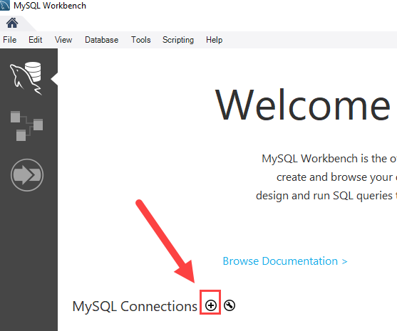
Creating a Database in MySQL Workbench
To create a new database using the MySQL Workbench, you follow these steps:
First, launch the MySQL Workbench and click the setup new connection button as shown in the following screenshot:

Slide 35
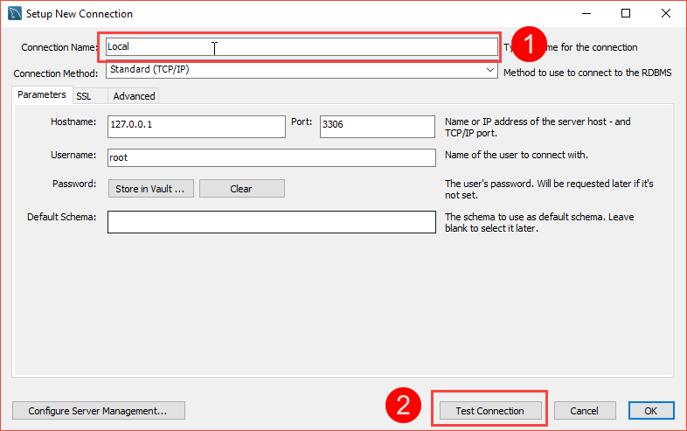
Creating a Database in MySQL Workbench Cont..
Second, type the name for the connection and click the Test Connection button.

Slide 36
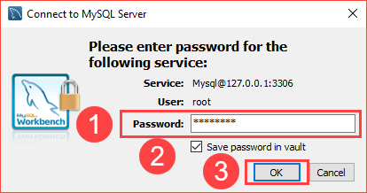
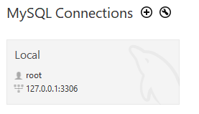
Creating a Database in MySQL Workbench Cont..
MySQL Workbench displays a dialog asking for the password of the root user:
You need to (1) type the password for the root user, (2) check the Save password in vault, and (3) click OK button.
Third, double-click the connection name Local to connect to the MySQL Server.

Slide 37
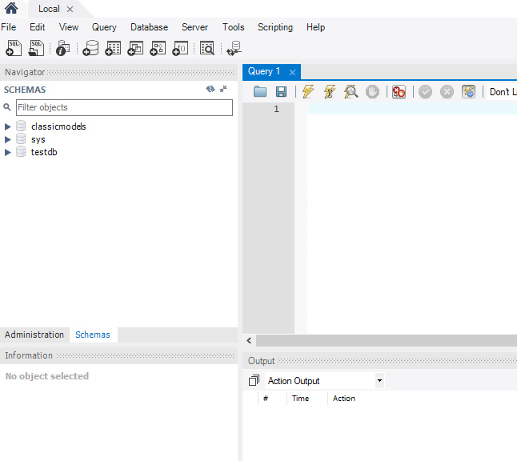
Creating a Database in MySQL Workbench Cont..
MySQL Workbench opens the following window which consists of four parts: Navigator, Query, Information, and Output.

Slide 38
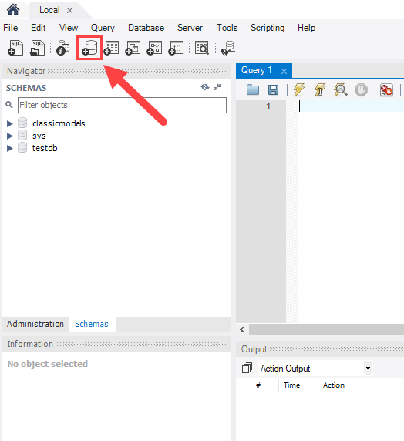
Creating a Database in MySQL Workbench Cont..
Fourth, click the create a new schema in the connected server button from the toolbar:

Slide 39
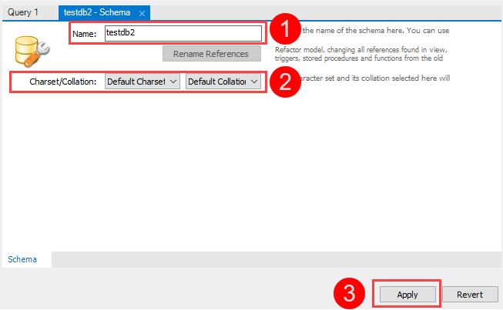
Creating a Database in MySQL Workbench Cont..
In MySQL, the schema is the synonym for the database.
Creating a new schema also means creating a new database.
Fifth, the following window is open.
You need to (1) enter the schema name, (2) change the character set and collation if necessary, and click the Apply button:

Slide 40
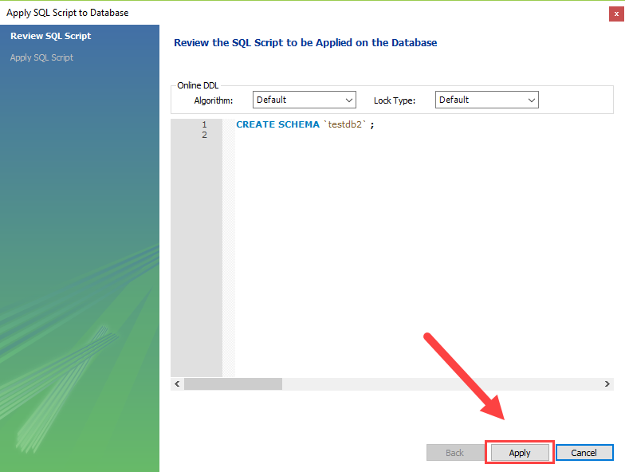
Creating a Database in MySQL Workbench Cont..
Sixth, MySQL Workbench opens the following window that displays the SQL script that will be executed.
Note that the CREATE SCHEMA statement command has the same effect as the CREATE DATABASE statement.

Slide 41
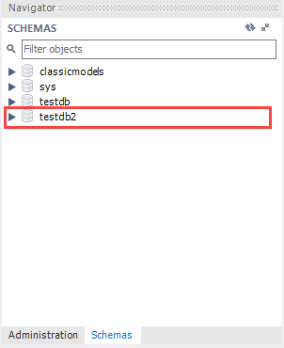
Creating a Database in MySQL Workbench Cont..
If everything is fine, you will see the new database created and shown in the schemas tab of the Navigator section.

Slide 42
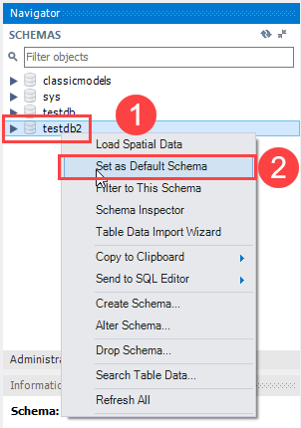
Creating a Database in MySQL Workbench Cont..
Seventh, to select the testdb2 database, (1) right-click the database name and (2) choose Set as Default Schema menu item:

Slide 43
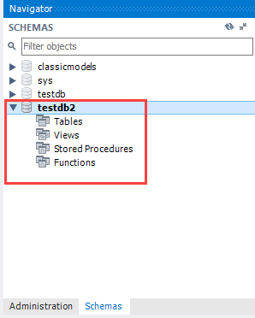
Creating a Database in MySQL Workbench Cont..
The testdb2 node is open as shown in the following screenshot.
Now, you can work with testdb2 from the MySQL Workbench.

Slide 44
Deleting an Existing Database in MySQL
The DROP DATABASE statement drops all tables in the database and deletes the database permanently. Therefore, you need to be very careful when using this statement.
The following shows the syntax of the DROP DATABASE statement:
  DROP DATABASE [IF EXISTS] database_name;
In this statement, you specify the name of the database which you want to delete after the DROP DATABASE keywords.
If you drop a database that does not exist, MySQL will issue an error.
To prevent an error from occurring if you delete a non-existing database, you can use the IF EXISTS option. In this case, MySQL will terminate the statement without issuing any error.
The DROP DATABASE statement returns the number of tables it deleted.
In MySQL, the schema is the synonym for the database. Therefore, you can use them interchangeably:
  DROP SCHEMA [IF EXISTS] database_name;

Slide 45
Deleting an Existing Database in MySQL
First, log in to the MySQL Server using the root user:
  mysql -u root –p
Type the password for the root user and press Enter.
  Enter password: ********
Second, display all the databases using the SHOW DATABASES statement:
  SHOW DATABASES; (Output shown on right side)
Third, drop the testdb database by issuing the DROP DATABASE statement:
  DROP DATABASE testdb;
Output:
  Query OK, 0 rows affected (0.03 sec)
MySQL returned zero affected rows indicating that the testdb database has no tables.
Output:
  +--------------------+
  | Database |
  +--------------------+
  | classicmodels |
  | information_schema |
  | mysql |
  | performance_schema |
  | sys |
  | testdb |
  | testdb2 |
  +--------------------+
  7 rows in set (0.00 sec)

Slide 46
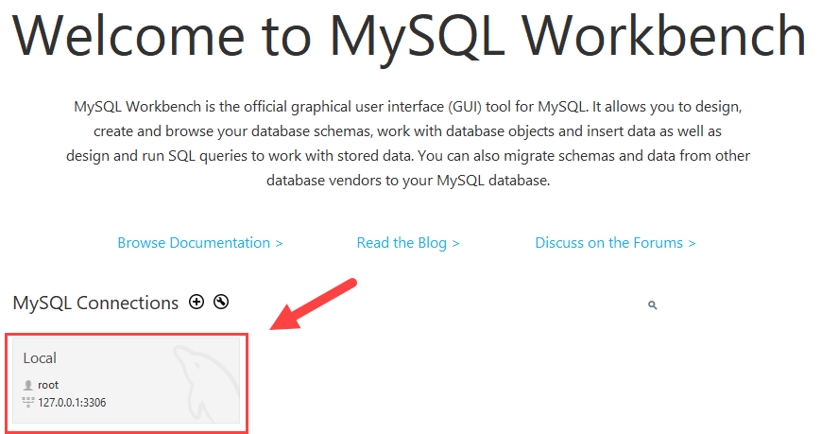
Deleting an Existing Database in MySQL Workbench
First, launch the MySQL workbench and log in to the MySQL Server.

Slide 47
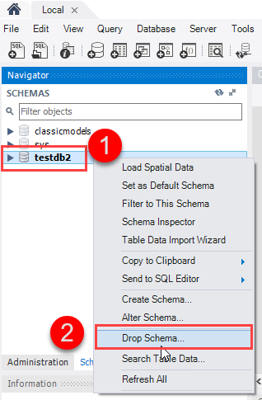
Deleting an Existing Database in MySQL Workbench…
Second, right-click the database that you want to remove, for example, testdb2 and choose the Drop Schema... option.

Slide 48
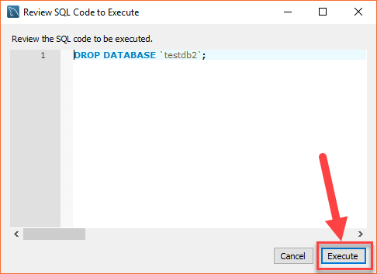
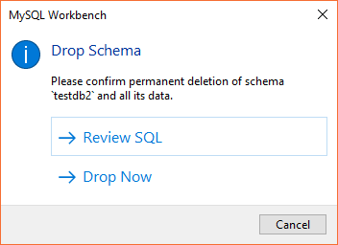
Deleting an Existing Database in MySQL Workbench…
Third, MySQL Workbench displays a dialog to confirm the deletion.
If you choose Review SQL, you’ll see the SQL statement that will be executed.
If you choose Drop Now, it’ll delete the database immediately.
To be safe, let’s choose Review SQL:

Slide 49
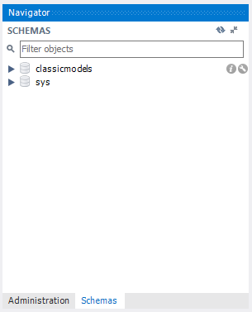

Deleting an Existing Database in MySQL Workbench…
Fourth, once you are sure that the SQL statement is going to drop the right database, you can click the Execute button to execute the statement.
MySQL returns the following output indicating that the database is dropped successfully. Because the testdb2 is an empty database, the number of affected rows is zero.
If you view the schemas pane, you will see that the testdb2 is not on the list anymore.

Slide 50
THANK YOU

